Slide 1
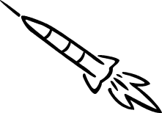

Mid Body Laser Designated Guidance Section Design
January 6th, 2008
Team Carpe Noctem
TDC1 FALL

Slide 2
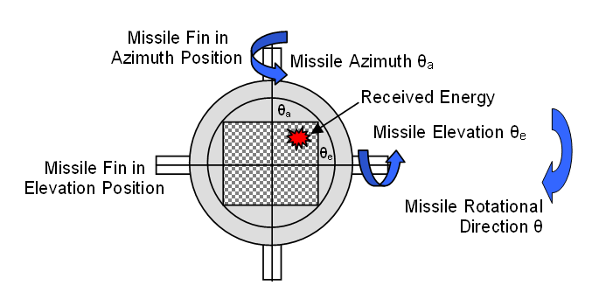
Problem Statement
Customer requests stability analysis for laser guided missile
Design control system if missile is unstable
Requirements for Stability
  Less then 20% Over Shoot
  Reaches 2% Final Value in 0.6 Seconds
TDC1 FALL

Slide 3
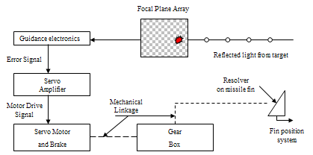
System Description
System Diagram provided by customer
TDC1 FALL

Slide 4

Missile Selection
AIM-7F/M Sparrow
Primary function: Air-to-Air missile
Dimensions: Length 12 ft., Diameter 8 in., Wingspan 3 ft. 4 in.
Speed: 782.32 m/s
Range: 32186.88 m → 22531.0 m
TDC1 FALL

Slide 5




Current Control System
JC
WF
N
AN
JCWF
TDC1 FALL

Slide 6
TDC1 FALL

Slide 7

TDC1 FALL

